Slide 1
Types of Games and Nash Equilibria
Ravi Kiran

Slide 2
Types of games
1 Cooperative and non-cooperative games
In cooperative games the players can communicate with each other and collude. They can also enter into third-party enforceable binding contracts.
This type of activity is expressly prohibited by law in developed countries.
Cooperative games are the one’s in which players are convinced to adopt a particular strategy through negotiations & agreements between players.
In prisoner’s dilemma, in case, John and Mac (two prisoners) had been able to contact each other, then they must have decided to remain silent.
Therefore, their negotiation would have helped in solving out the problem.

Slide 3
Cooperative and Non-Cooperative Games
Another example could be pan-masala organizations. Suppose pan masala organizations have high ad-expenditure that they want to reduce. However, they are not sure whether other organizations would follow them or not.
This creates a situation of dilemma among pan masala organizations.
However, the government restricts the advertisement of pan masala on televisions.
This would help in reducing the ad-expenditure of pan masala organizations.
This is an example of cooperative game.

Slide 4
Non-cooperative games
However, non-cooperative games refer to the games in which the players decide on their own strategy to maximize their profit.
The best example of a non-cooperative game is prisoner’s dilemma.
Non-cooperative games provide accurate results.
This is because in non-cooperative games, a very deep analysis of a problem takes place.

Slide 5
2. Normal Form and Extensive Form Games
Normal form games refer to the description of game in the form of matrix.
In other words, when the payoff and strategies of a game are represented in a tabular form, it is termed as normal form games.
Normal form games help in identifying the dominated strategies and Nash equilibrium.
In normal form games, the matrix demonstrates the strategies adopted by the different players of the game and their possible outcomes.

Slide 6
2. Normal Form and Extensive Form Games
Extensive form games are the one in which the description of game is done in the form of a decision tree.
Extensive form games help in the representation of events that can occur by chance.
These games consist of a tree-like structure in which the names of players are represented on different nodes.

Slide 7
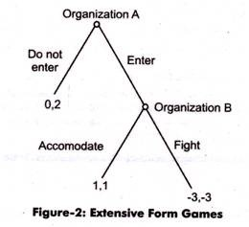
Decision tree
Suppose organization A wants to enter a new market, (entrant) while organization B is the existing organization (incumbent) in that market.
Organization A has two strategies:
i) to enter the market & challenge to survive (or)
ii)do not enter the market and remain deprived of the profit that it can earn.
Similarly, organization B also has two strategies:
either to fight for its existence (or)
to cooperate with organization A.

Slide 8
Organization A takes the first step that would be followed by organization B later on.
In case, organization A does not enter the market, then its payoffs would be zero. However, if it enters the market, the market situation would be totally dependent on organization B.
If they both get into the price war, then both of them would suffer the loss of 3.
On the other hand, if organization B cooperates, then both of them would earn equal profits.
In this case, the best option would be that organization A enters the market and organization B cooperates

Slide 9
3. Simultaneous Move Games and Sequential Move Games
Simultaneous games are the one’s in which the move of two players (the strategy adopted by two players) is simultaneous.
A sequential game involves multiple players who do not make decisions simultaneously, and one player's decision affects the outcomes and decisions of other players. A sequential game is represented by a game tree (also called the extensive form) with players moving sequentially. Games such as chess, tic-tac-toe are examples of sequential games.

Slide 10
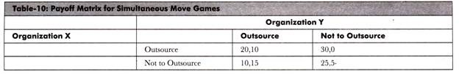
The payoff matrix for the two organizations
Simultaneous games are represented in normal form while sequential games are represented in extensive form.
While sequential games are played by turn, simultaneous games are played with each player making their decision at the same time

Slide 11
It can be seen that both the organizations X and Y are unaware about the strategy of each other.
Both of them work on the perception that the other one would adopt the best strategy for itself.
Therefore, both the organizations would adopt the strategy, which is best for them.

Slide 12
https://www.youtube.com/watch?v=qtZIrtZmmV8

Slide 13
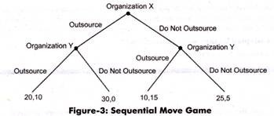
Sequential move games.
Suppose organization X is the first one to decide whether it should outsource the marketing activities or not.
The game tree that represents the decision of organization X and Y is shown in Figure.

Slide 14
The first move is taken by organization X while organization Y would take decision on the basis of the decision taken by X.
However, the final outcome depends on the decision of organization Y.
In the present case, the second player is aware of the decision of the first player.

Slide 15
4. Constant Sum, Zero Sum, and Non-Zero Sum Games
Constant sum game is the one in which the sum of outcome of all the players remains constant even if the outcomes are different.
Zero sum game is a type of constant sum game in which the sum of outcomes of all players is zero.
In zero sum game, the strategies of different players cannot affect the available resources.
Moreover, in zero sum game, the gain of one player is always equal to the loss of the other player.
On the other hand, non-zero sum game are the games in which sum of the outcomes of all the players is not zero.

Slide 16
Constant Sum, Zero Sum, and Non-Zero Sum Games
A non-zero sum game can be transformed to zero sum game by adding one dummy player. The losses of dummy player are overridden by the net earnings of players.
Examples of zero sum games are chess and gambling.
In these games, the gain of one player results in the loss of the other player.
However, cooperative games are the example of non-zero games.
This is because in cooperative games, either every player wins or loses.

Slide 17
5. Symmetric and Asymmetric Games:
In symmetric games, strategies adopted by all players are same.
Symmetry can exist in short-term games only because in long-term games the number of options with a player increases.
The decisions in a symmetric game depend on the strategies used, not on the players of the game.
Even in case of interchanging players, the decisions remain the same in symmetric games.
Example of symmetric games is prisoner’s dilemma.

Slide 18
Asymmetric games
Asymmetric games are the one’s in which strategies adopted by players are different. In asymmetric games, the strategy that provides benefit to one player may not be equally beneficial for the other player.
However, decision making in asymmetric games depends on the different types of strategies and decision of players.
Example of asymmetric game is entry of new organization in a market because different organizations adopt different strategies to enter in the same market.

Slide 19
THANKS

